Slide 1


Slide 2
PROJECT ON HI-TECH COLLEGE MANAGEMENT SYSTEM
Developed by
Name : Rahul.E Reg. No.: R140030100722

Slide 3
SYSTEM ANALYSIS
The Hi-Tech College Management System involves the creation of a Web Application that will enables its users to:
When used by students to:
View and update their details in a neat interface.
View their attendance records.
View their exam scores.
View and register for courses online.
When used by teachers to:
View the students that are appointed for them.
Update the attendance of the students.
Update the exam scores of the students.
When used by the administrator:
To view, add, edit or delete student records.
To view, add, edit or delete the courses available.
To view, add, edit or delete the teachers employed.
To view, add, edit or delete the information regarding the users who have access to the application.

Slide 4
Each of the three type of users are also able to change their passwords.
Hi-Tech College Management System has a computerized system in a place that maintains the details of all the students, courses, teachers and users. The proposed Web application will use the database created to obtain the above mentioned details. Some additional tables may have to be created in the database to accommodate the specific requirements of the Web application.

Slide 5
HARDWARE AND SOFTWARE REQUIREMENTS
Hardware:
A node with PIII Processor(800 MHz or higher), SCSI Hard disk of 20GB, 256MB RAM, CDROM and
1-10/100 Mbps network card.
Operating System:
Windows XP Professional with SP2.
Software:
Microsoft Visual Studio 2008 Professional Edition, Microsoft Windows XP Service Pack (SP),
SQL Server 2008 Standard Edition.

Slide 6
ACTIVITY DIAGRAM FOR VIEWING AND UPDATING STUDENT DETAILS

Slide 8
ACTIVITY DIAGRAM FOR REGISTERING AND VIEWING COURSES ONLINE

Slide 10
ACTIVITY DIAGRAM FOR VIEWING ATTENDANCE SUMMARY AND EXAM REPORTS

Slide 12
USE CASE DIAGRAM FOR FUNCTIONALITIES AVAILABLE TO A STUDENT

Slide 14
USE CASE DIAGRAM FOR FUNCTIONALITIES AVAILABLE TO A TEACHER

Slide 16
USE CASE DIAGRAM FOR FUNCTIONALITIES AVAILABLE TO AN ADMINISTRATOR

Slide 18
SNAPSHOTS

Slide 19
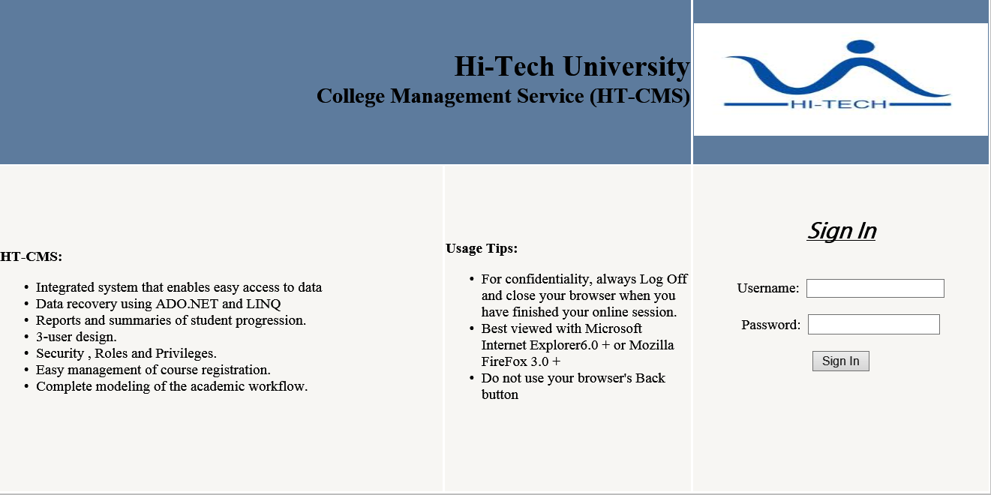
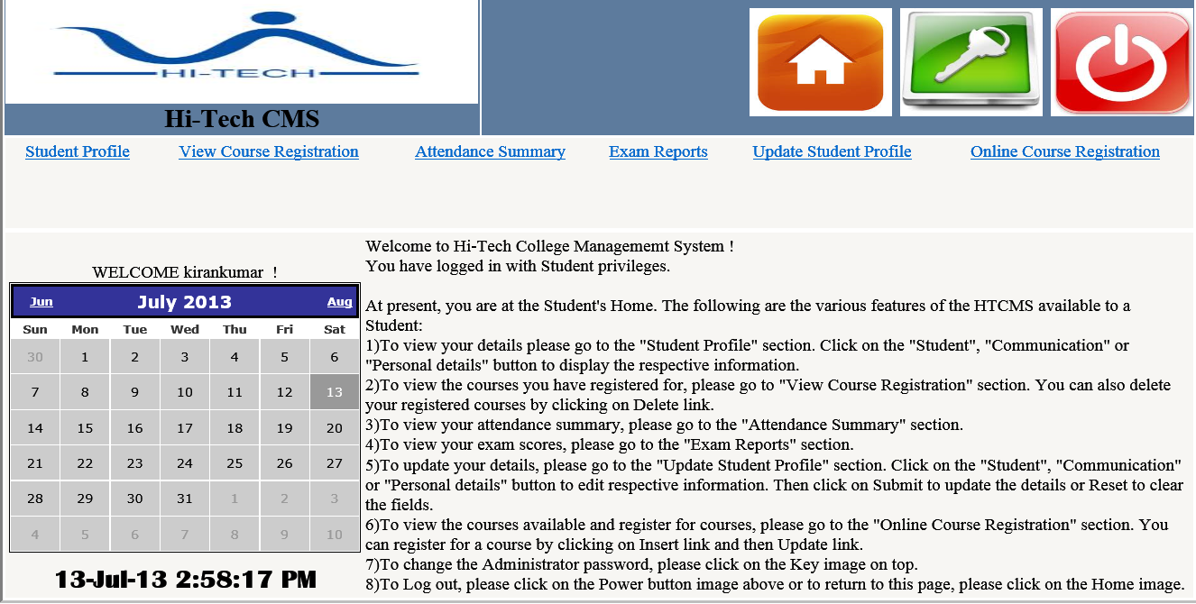
LOGIN PAGE:
STUDENT HOME:

Slide 20
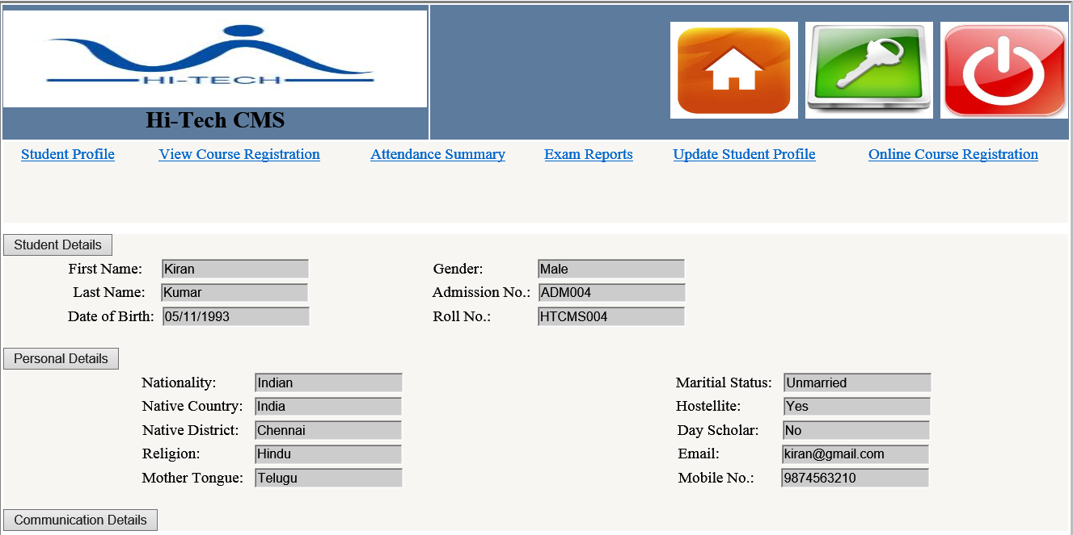
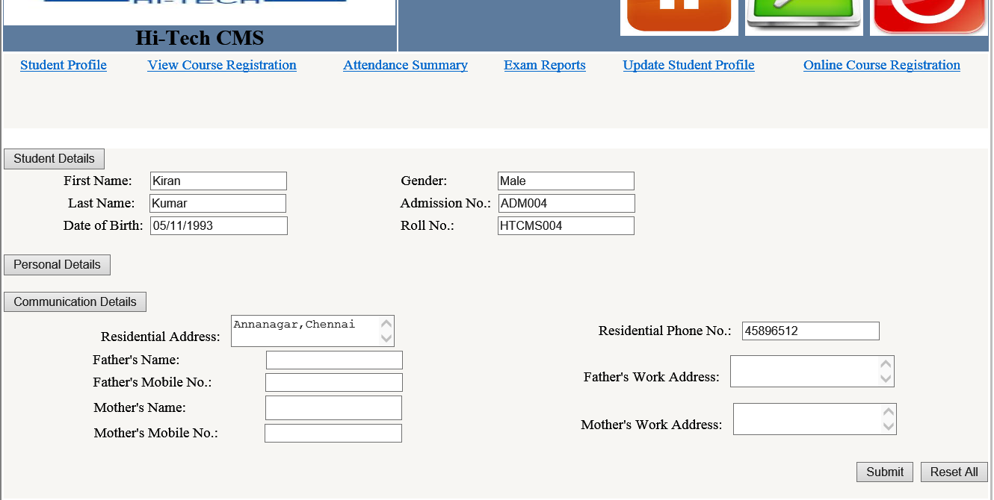
STUDENT PROFILE:
UPDATE STUDENT PROFILE:

Slide 21
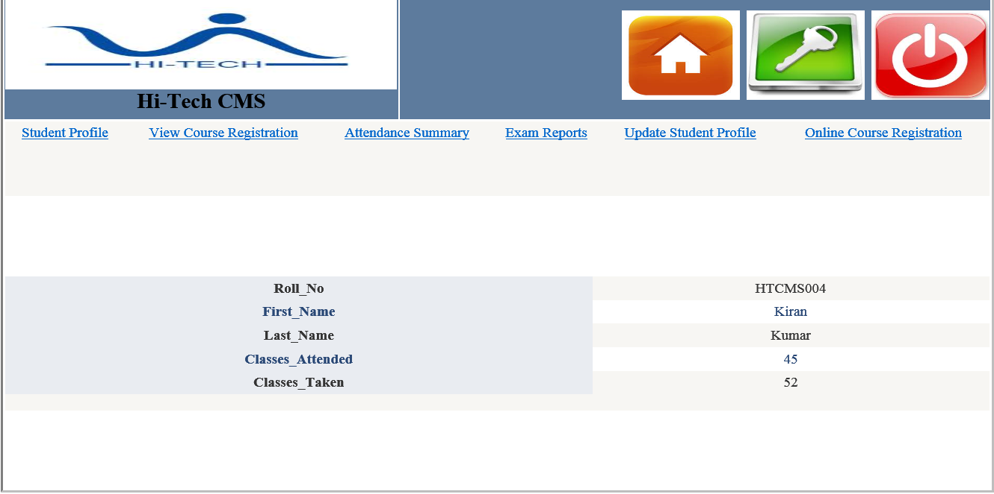
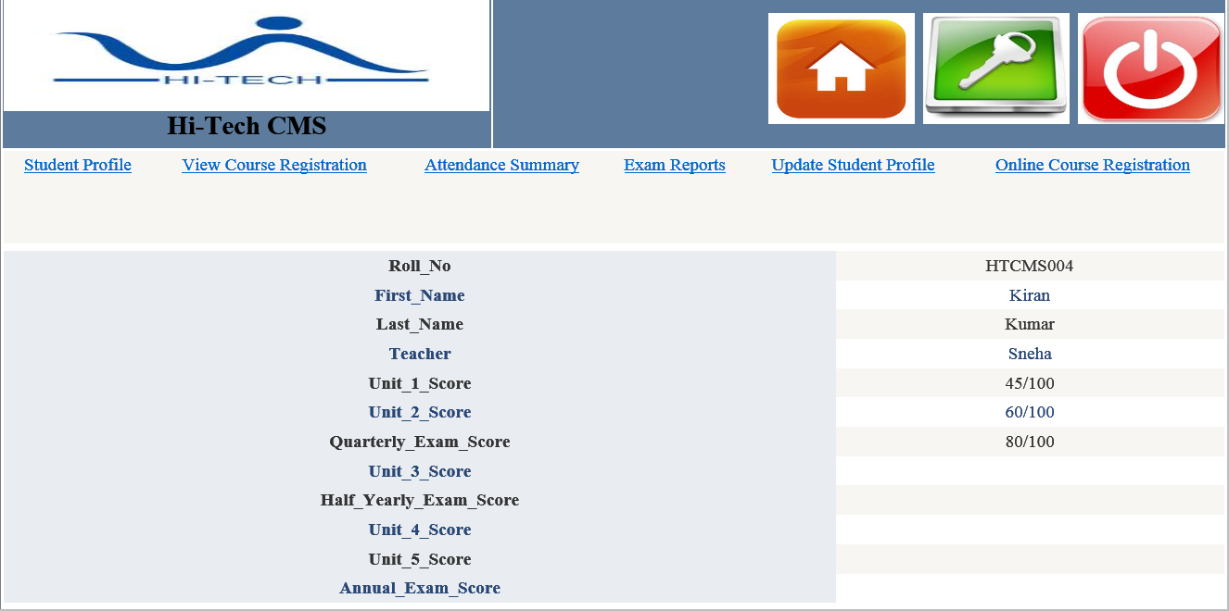
ATTENDANCE SUMMARY:
EXAM REPORTS:

Slide 22
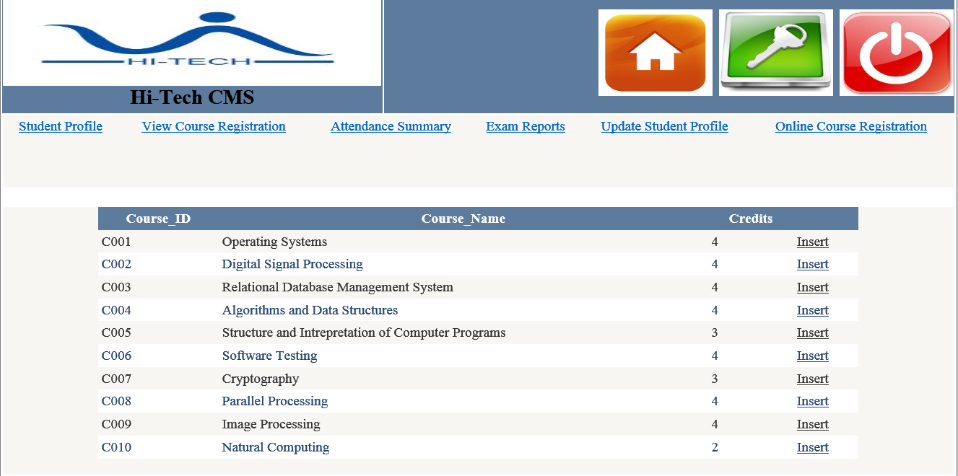
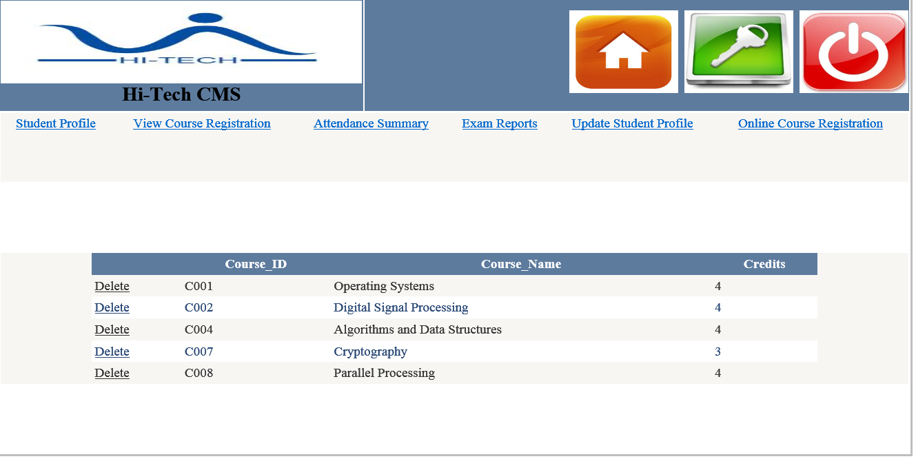
ONLINE COURSE REGISTRATION:
VIEW COURSE REGISTRATION:

Slide 23
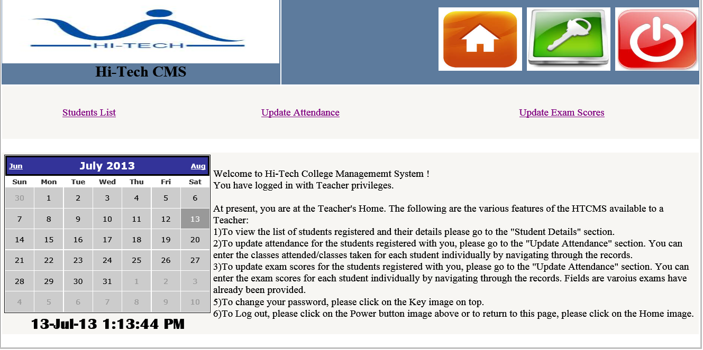
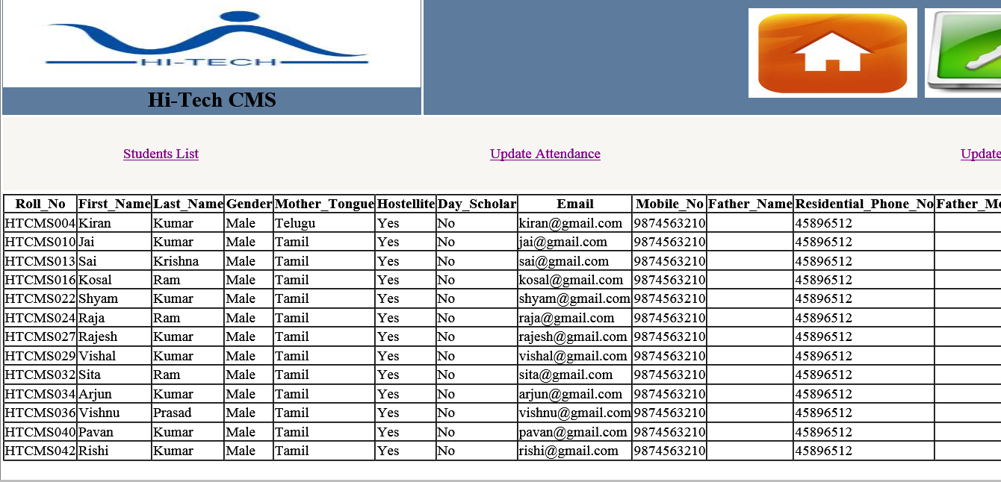
TEACHER HOME:
STUDENTS LIST:

Slide 24
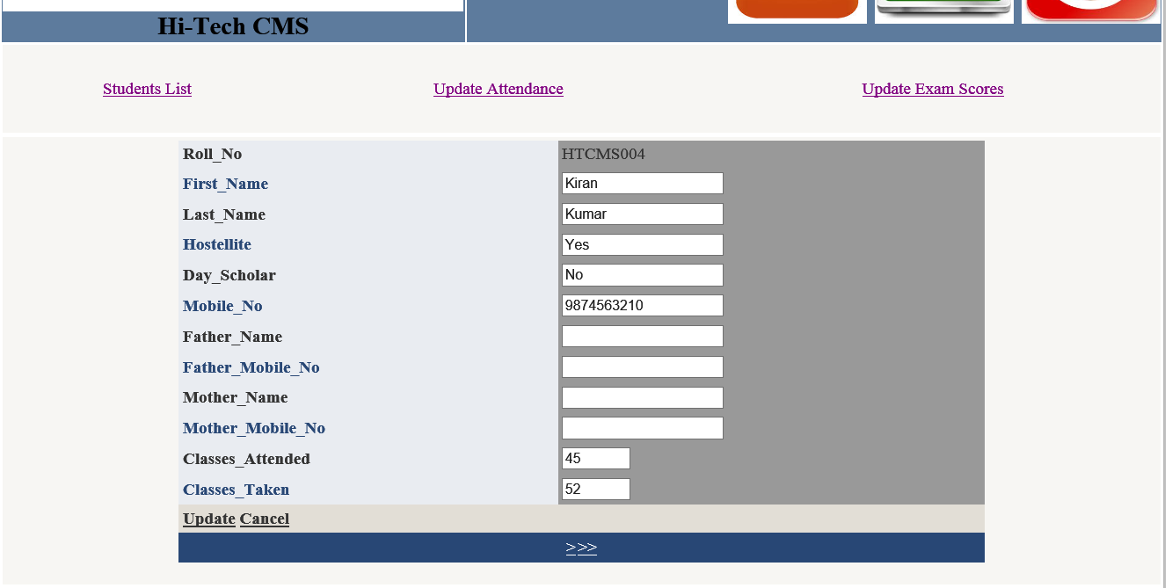
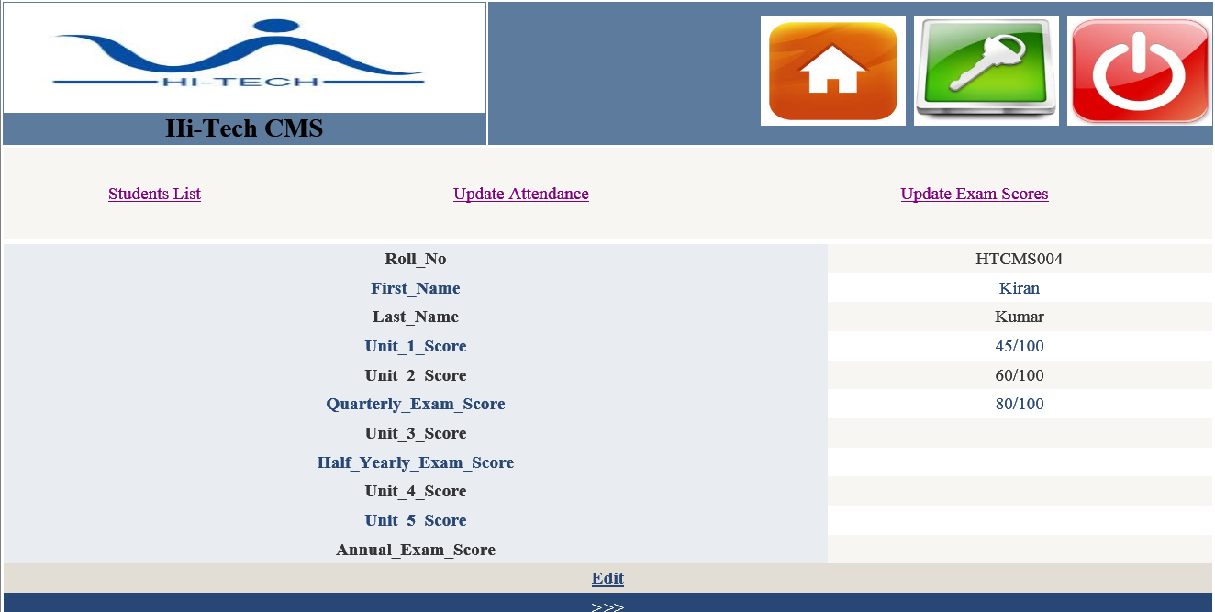
UPDATE ATTENDANCE:
UPDATE EXAM SCORES:

Slide 25
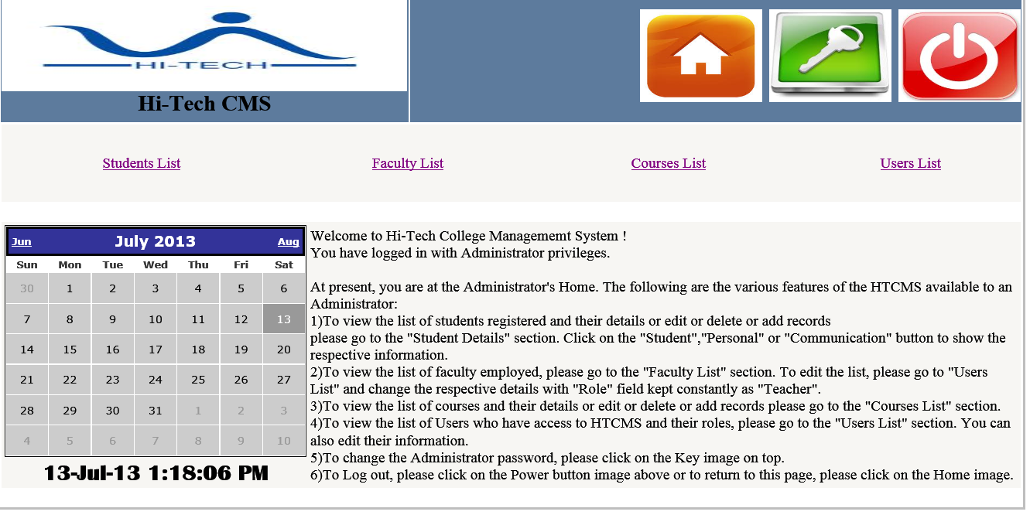
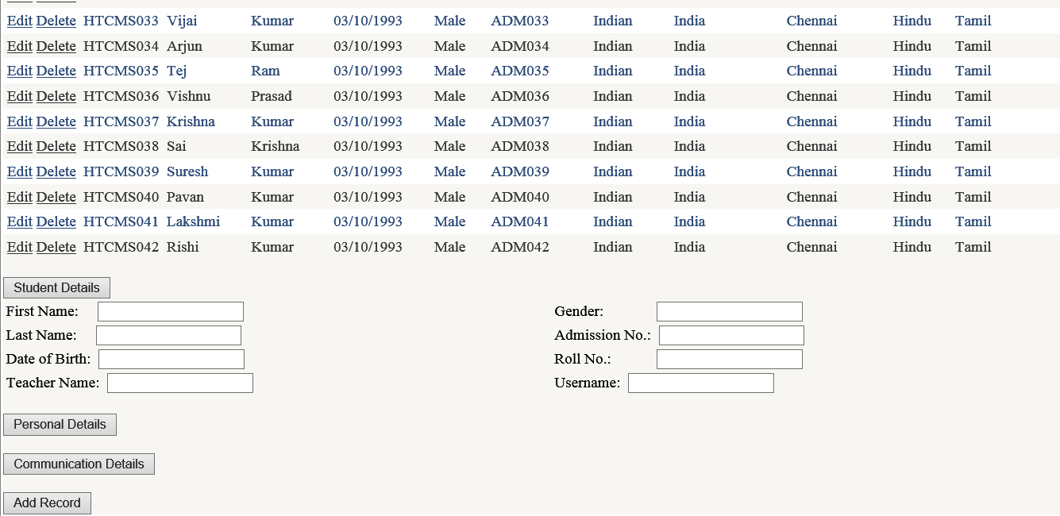
ADMINISTRATOR HOME:
STUDENTS LIST:

Slide 26
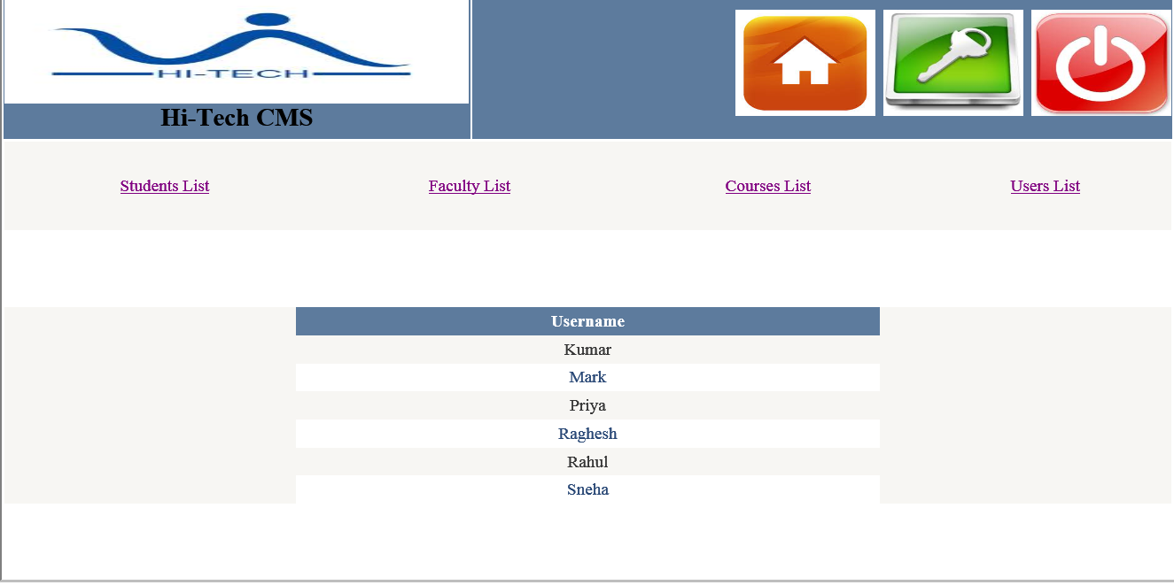
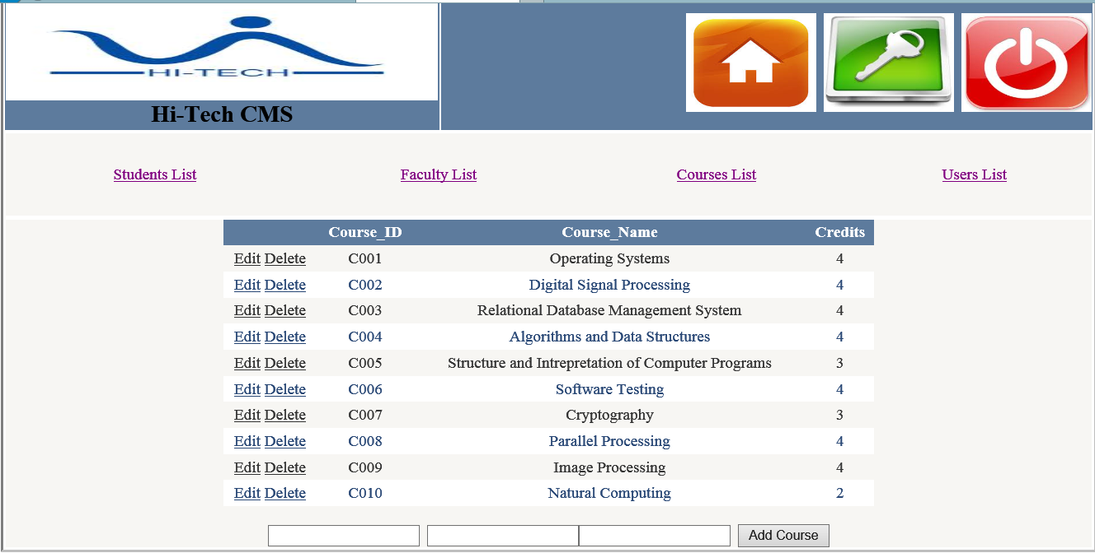
FACULTY LIST:
COURSES LIST:

Slide 27
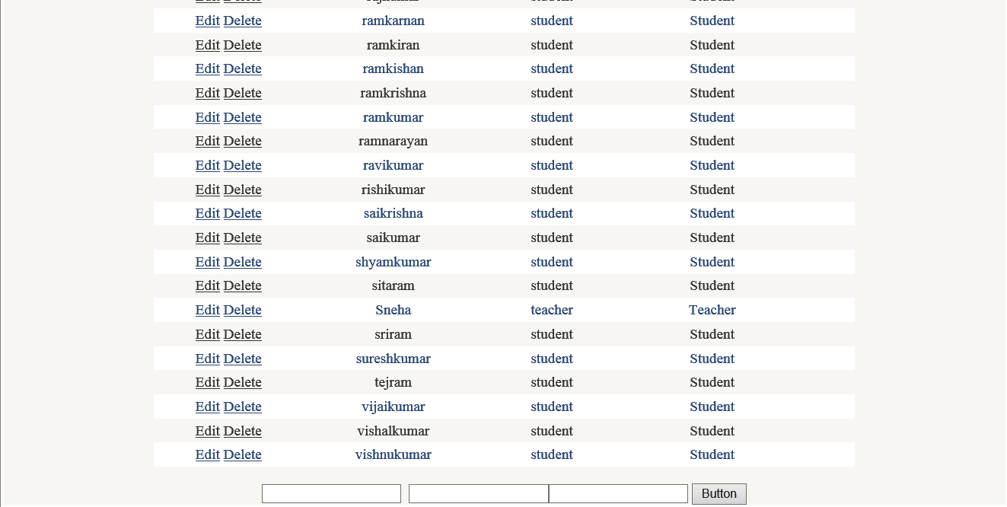
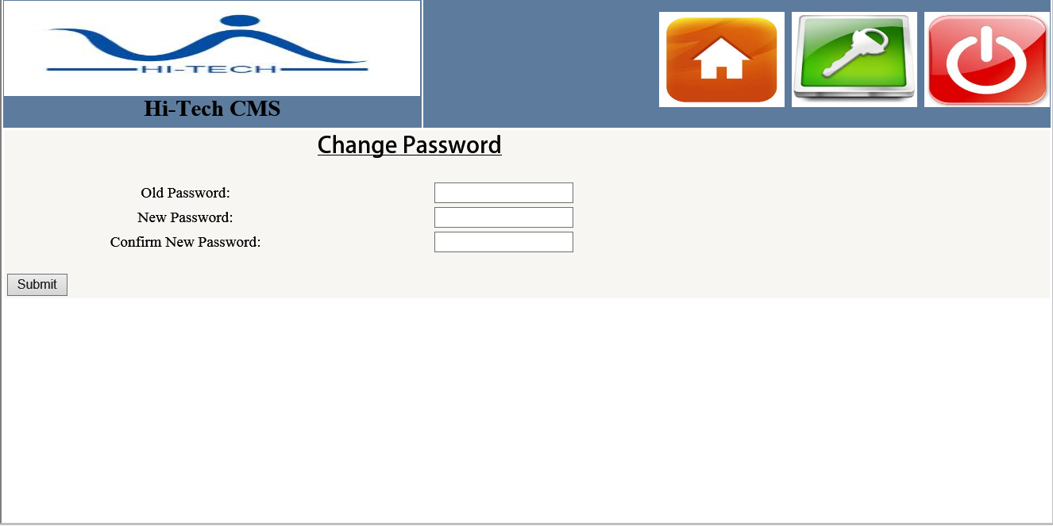
USERS LIST:
CHANGE PASSWORD:

Slide 28


Slide 30


